Slide 1
Chapter 5: Networking Concepts
Instructor Materials
IT Essentials v7.0
Notes:
Cisco Networking Academy Program
IT Essentials 7.0
Chapter 5: Networking Concepts

Slide 2
Instructor Materials – Chapter 5 Planning Guide
This PowerPoint deck is divided in two parts:
Instructor Planning Guide
Information to help you become familiar with the chapter
Teaching aids
Instructor Class Presentation
Optional slides that you can use in the classroom
Begins on slide #13
Note: Remove the Planning Guide from this presentation before sharing with anyone.
Notes:
2

Slide 3
Chapter 5: Networking Concepts
IT Essentials 7.0 Planning Guide
Notes:
Cisco Networking Academy Program
IT Essentials v7.0
Chapter 5: Networking Concepts

Slide 4
Check Your Understanding and What Do You Already Know?
Check Your Understanding activities used to be called Interactive Activities. They simply have a new name. They are designed to let students quickly determine if they understand the content and can proceed, or if they need to review.
Check Your Understanding activities do not affect student grades.
Activities listed as What Do You Already Know? are a type of activity in which we ask the student to simply take a guess! It is not meant to evaluate their knowledge. It is only meant to give them a head start in thinking about different topics before they are presented in the course. Students receive addition content in the form of feedback for any answers they select.
What Do You Already Know? activities do not directly affect student grades; however, the feedback may contain content which appears later in quizzes and exams, so it is important that students complete the What Do You Already Know? activities.
There are no separate slides for these activities in the PPT. They are listed in the notes area of the slide that appears before these activities.
Notes:
4

Slide 5
Chapter 5: Activities
What activities are associated with this chapter?
Page # | Activity Type | Activity Name | Optional?
5.1.1.3 | Check Your Understanding | Types of Networks | Recommended
5.1.2.7 | Check Your Understanding | Internet Connection Types | Recommended
5.2.1.1 | Video Explanation | Transport Layer Protocols | Recommended
5.2.1.2 | Interactive Activity | Transport Layer Protocols | Recommended
5.2.1.6 | Check Your Understanding | Transport Layer Protocols | Recommended
5.2.2.1 | Video Explanation | Application Port Numbers | Recommended
5.2.2.3 | Check Your Understanding | Application Port Numbers | Recommended
5.2.3.5 | Check Your Understanding | Wireless Protocols | Recommended
5.2.4.1 | Video Explanation | Network Services | Recommended
5.2.4.12 | Check Your Understanding | Network Services | Recommended
5.3.1.1 | Video Explanation | Basic Network Devices | Recommended
5.3.1.7 | Check Your Understanding | Basic Network Devices | Recommended
Notes:
5

Slide 6
Chapter 5: Activities (Cont.)
What activities are associated with this chapter?
Page # | Activity Type | Activity Name | Optional?
5.3.2.1 | Video Explanation | Security Devices | Recommended
5.3.2.6 | Check Your Understanding | Security Devices | Recommended
5.3.3.5 | Check Your Understanding | Other Network Devices | Recommended
5.4.1.1 | Video Explanation | Network Cable Tools | Recommended
5.4.1.3 | Check Your Understanding | Network Tools | Recommended
5.4.2.6 | Check Your Understanding | Cable Pinouts | Recommended
5.4.2.7 | Video Demonstration | Build and Test a Network Cable | Recommended
5.4.2.8 | Lab | Build and Test Network Cables | Optional
5.4.3.4 | Check Your Understanding | Fiber Cables and Connectors | Optional
Notes:
6

Slide 7
Chapter 5: Assessment
Students should complete Chapter 5, “Assessment” after completing Chapter 5.
Quizzes, labs, and other activities can be used to informally assess student progress.
Notes:
7

Slide 8
Chapter 5: Best Practices
Prior to teaching Chapter 5, the instructor should:
Complete Chapter 5, “Assessment.”
The objectives of this chapter are:
Explain components and types of computer networks.
Explain networking protocols, standards, and services.
Explain the purpose of devices on a network.
Explain the characteristics of network cables.
Notes:
8

Slide 9
Chapter 5: Best Practices (Cont.)
In teams or individually, have students diagram their home network on a white board, sheet of paper, or graphics program.
Have students provide examples of PANs, LANs, WANs, etc.
Students should be able to compare the operation of TCP and UDP and give examples of applications that each use. Emphasize that there are fewer UDP protocols than TCP protocols.
Have a class discussion on the Internet of Things (IoT), smart home devices, and two of the protocols used with smart home devices—Zigbee and Z-Wave.
Ensure students know the purpose of the following network devices: NIC, hub, switch, wireless access point, router. Have a sample one of these to pass around or work in teams to identify. Otherwise, have photos on a slide of the different devices and have them describe the difference as well as identify.
Be sure to talk about pressing down on the tang to release a UTP cable from an RJ-45 port.
Notes:
9

Slide 10
Chapter 5: Best Practices (Cont.)
If working in a computer classroom, unplug the network cable in the classroom and have the students see which wiring standard is used as you discuss UTP network cabling standards.
Invite the computer technician for the school into the classroom and ask the person to bring their 5 – 10 most used tools. Ask them to pass the tool around and tell the students what they use the tool for.
For internet connection types, have them access the internet and see what types are available in the area. If internet access is not allowed, include the internet options that are available and let the students describe what type they have at home and what they like or don’t like about it. You can supplement with material from the curriculum with their explanation.
Notes:
10

Slide 11
Chapter 5: Additional Help
For additional help with teaching strategies, including lesson plans, analogies for difficult concepts, and discussion topics, visit the ITE Community at: https://community.cisco.com/t5/networking-academy/ct-p/Netacad, or simply go to https://community.cisco.com.
If you have lesson plans or resources that you would like to share, upload them to the ITE Community in order to help other instructors.
Notes:
11

Slide 13
Chapter 5: Networking Concepts
IT Essentials v7.0
Notes:
Cisco Networking Academy Program
IT Essentials v7.0
Chapter 5: Networking Concepts

Slide 14
Chapter 5 - Sections & Objectives
5.1 Network Components and Types
Explain components and types of computer networks.
Describe the types of networks.
Describe internet connection types.
5.2 Network Protocols, Standards, and Services
Explain networking protocols, standards and services.
Explain the purpose and characteristics of transport layer protocols.
Explain the significance of application port numbers.
Explain wireless protocols.
Explain network services.
Notes:
14
Cisco Networking Academy Program
IT Essentials v7.0
Chapter 5: Networking Concepts

Slide 15
Chapter 5 - Sections & Objectives (Cont.)
5.3 Network Devices
Explain the purpose of devices on a network.
Explain basic network devices.
Explain security devices.
Explain other network devices.
5.4 Network Cables
Explain the characteristics of network cables.
Describe networking tools and their purpose.
Explain the purpose and characteristics of common types of copper network cables and connectors.
Explain the purpose and characteristics of common types of fiber network cables and connectors.
Notes:
15
Cisco Networking Academy Program
IT Essentials v7.0
Chapter 5: Networking Concepts

Slide 16
5.1 Network Components and Types
Notes:
5 – Networking Concepts
5.1 – Network Components and Types

Slide 17
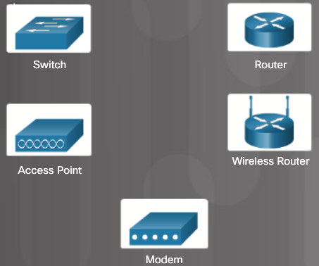
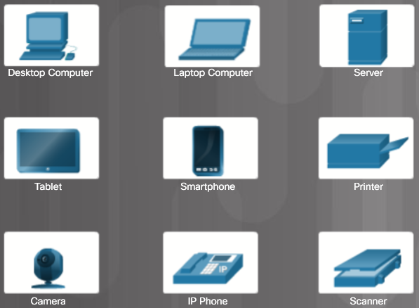
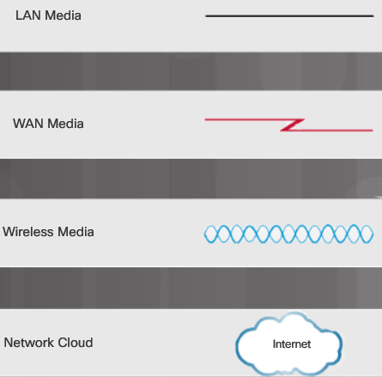
Types of Networks Network Icons
Network Media Icons
Intermediary Device Icons
Host Device Icons
Notes:
5.1 – Network Components and Types
5.1.1 – Types of Networks
5.1.1.1 – Network Icons

Slide 18
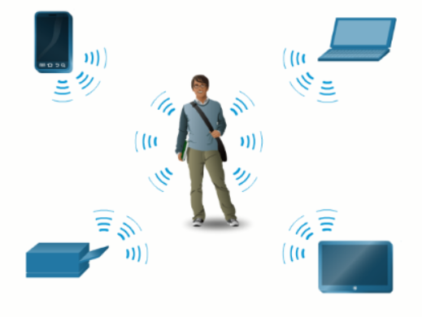
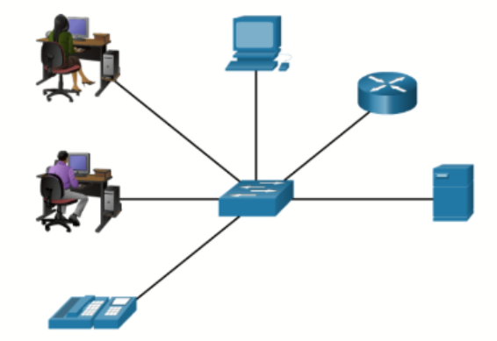
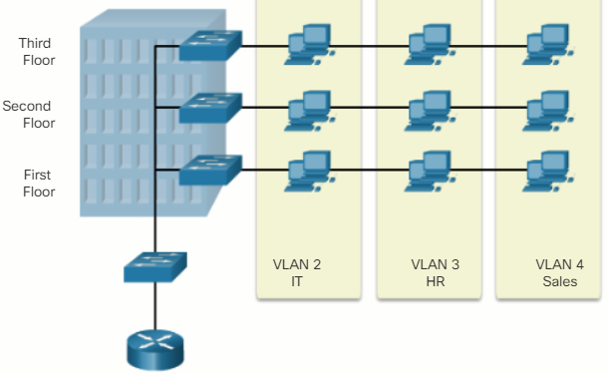
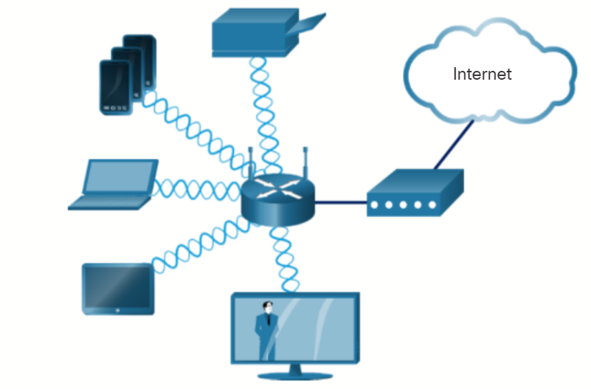
Types of Networks Network Topologies and Description
PAN (personal area network) – Commonly uses Bluetooth to connect mice, keyboards, phones, and tablets.
LAN (local area network) – A wired network consisting of a switch and network devices in a limited geographical area.
VLAN (virtual LAN) – Extends beyond a traditional LAN and groups users based on administratively defined boundaries such as department or floor.
WLAN (wireless LAN) – Connects multiple wireless devices and uses an access point.
Notes:
5.1 – Network Components and Types
5.1.1 – Types of Networks
5.1.1.2 – Network Topologies and Description
5.1.1.3 – Check Your Understanding – Types of Networks

Slide 19
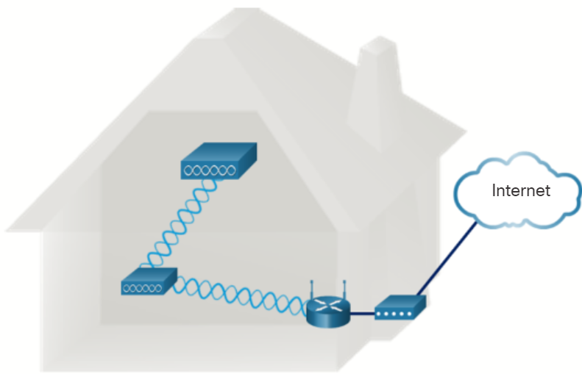
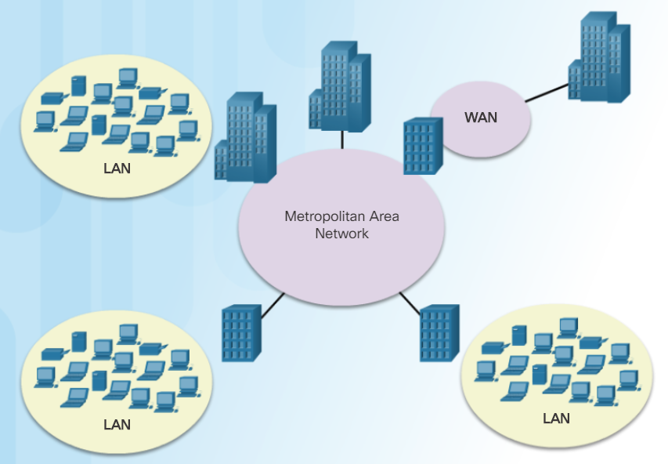
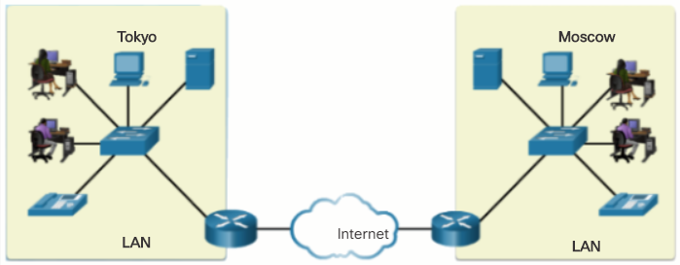
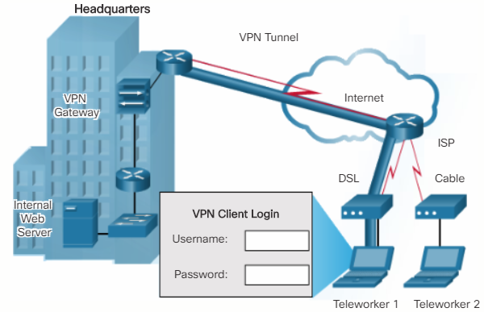
Types of Networks Network Topologies and Description
WMN (wireless mesh network) – Connects multiple wireless access points together to expand the wireless network.
MAN (metropolitan area network) – A network that spans a city.
WAN (wide area network) – A network that spans a large geographical area.
VPN (virtual private network) – A method of connecting to a network such as a company network across an unsecure network.
Notes:
5.1 – Network Components and Types
5.1.1 – Types of Networks
5.1.1.2 – Network Topologies and Description (Cont.)
5.1.1.3 – Check Your Understanding – Types of Networks

Slide 20
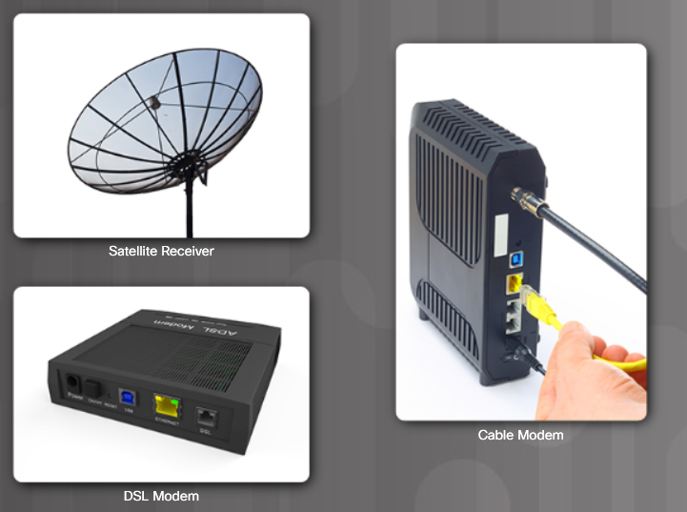
Internet Connection Types Brief History of Connection Technologies
Analog telephone access (dialup) – uses an analog modem to call another modem.
ISDN (Integrated Services Digital Network) – more bandwidth than dialup. Can carry voice, video, and data.
Broadband – uses different frequencies to send multiple signals over media.
Notes:
5.1 – Network Components and Types
5.1.2 – Internet Connection Types
5.1.2.1 – Brief History of Connection Technologies

Slide 21
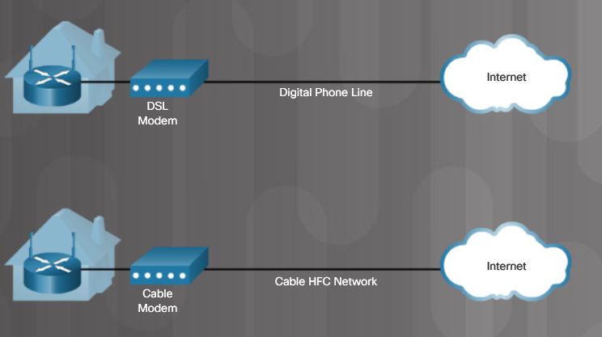
Internet Connection Types DSL, Cable, and Fiber
DSL (digital subscriber line) – always on technology that uses phone lines; voice and data carried on different frequencies; requires a filter on the port that connects to a phone.
Cable – Uses a cable modem to connect to a traditional cable TV network; shares the network with multiple subscribers.
Fiber – High bandwidth connection used in backbone networks, large enterprise environments, large data centers, and now part of some home internet connections.
Notes:
5.1 – Network Components and Types
5.1.2 – Internet Connection Types
5.1.2.2 – DSL, Cable, and Fiber

Slide 22
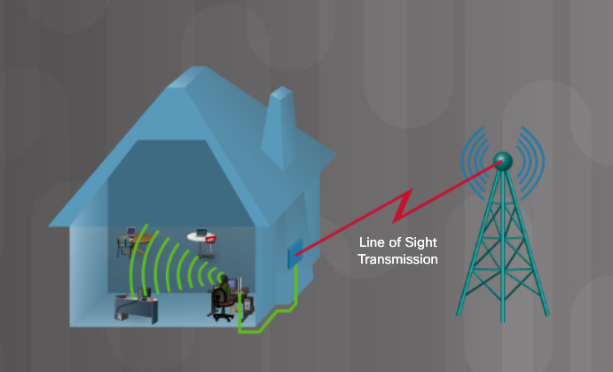
Internet Connection Types Line of Sight Wireless Internet Service
Line of site wireless – always on technology that uses radio signals for connecting to the internet.
Clear path required
Weather affects signal strength and performance
Notes:
5.1 – Network Components and Types
5.1.2 – Internet Connection Types
5.1.2.3 – Line of Sight Wireless Internet Service

Slide 23
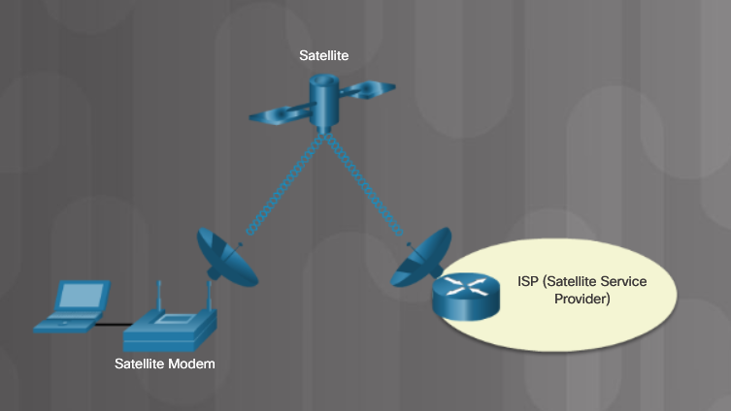
Internet Connection Types Satellite
Satellite – broadband technology for remote areas
Uses a satellite dish
Not a good solution for time-sensitive applications like gaming, Voice over Internet Protocol (VoIP), and video conferencing
Notes:
5.1 – Network Components and Types
5.1.2 – Internet Connection Types
5.1.2.4 – Satellite

Slide 24
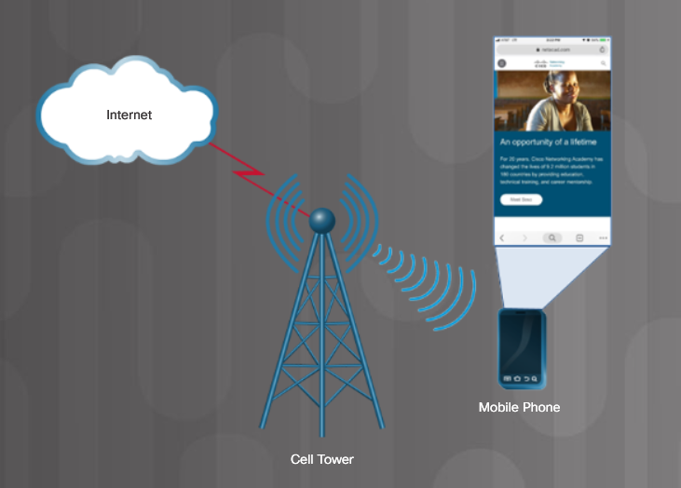
Internet Connection Types Cellular
Cellular– relies on cell towers to create a network used by cell phones and connectivity to the internet
Notes:
5.1 – Network Components and Types
5.1.2 – Internet Connection Types
5.1.2.5 – Cellular

Slide 25
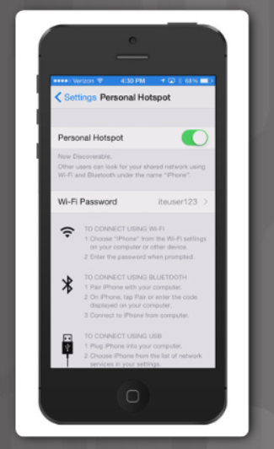
Internet Connection Types Mobile Hotspot and Tethering
Cell phone option that allows another device to connect to the internet using Wi-Fi, Bluetooth, or USB cable
The other device is using the phone’s cellular connection to connect to the internet
Called tethering or a hotspot
A mobile hotspot is when a cell phone allows Wi-Fi devices to connect and use the mobile data network.
Notes:
5.1 – Network Components and Types
5.1.2 – Internet Connection Types
5.1.2.6 – Mobile Hotspot and Tethering
5.1.2.7 – Check Your Understanding – Internet Connection Types

Slide 26
5.2 Networking Protocols, Standards, and Services
Notes:
5 – Networking Concepts
5.2 – Networking Protocols, Standards, and Services

Slide 27
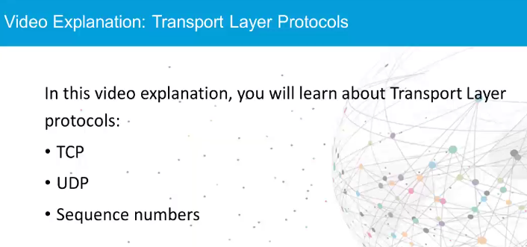
Video Explanation – Transport Layer Protocols Transport Layer Protocols
Notes:
5.2 – Network Protocols, Standards, and Services
5.2.1 – Transport Layer Protocols
5.2.1.1 – Video Explanation – Transport Layer Protocols
5.2.1.2 – Activity – Transport Layer Protocols

Slide 28
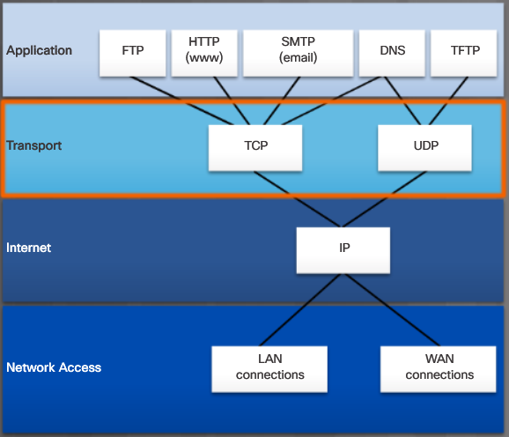
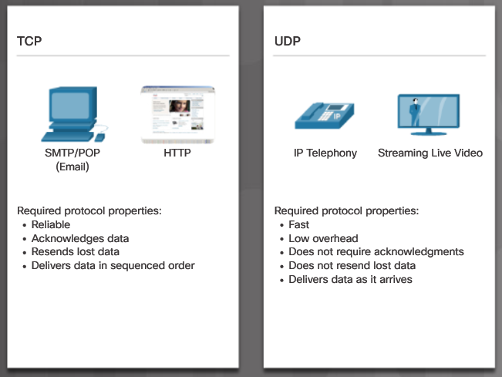
Transport Layer Protocols The TCP/IP Model
Notes:
5.2 – Network Protocols, Standards, and Services
5.2.1 – Transport Layer Protocols
5.2.1.3 – The TCP/IP Model

Slide 29
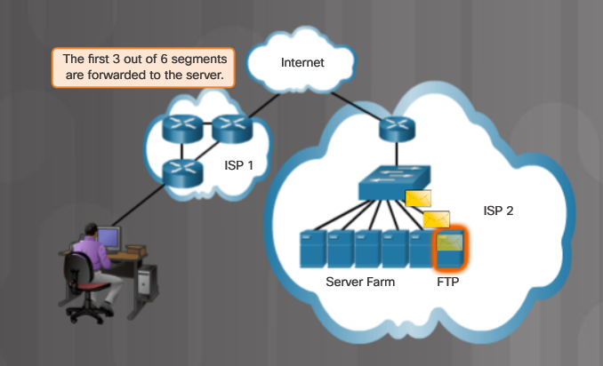
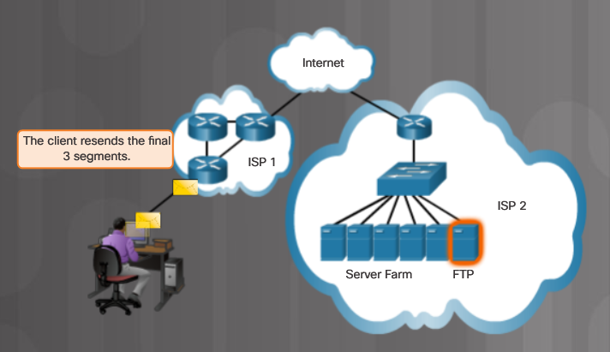
Transport Layer Protocols TCP
Three basic operations of reliability
Numbering and tracking of data segments
Acknowledgment of received data
Retransmitting any unacknowledged data after a period of time.
Notes:
5.2 – Network Protocols, Standards, and Services
5.2.1 – Transport Layer Protocols
5.2.1.4 – TCP

Slide 30
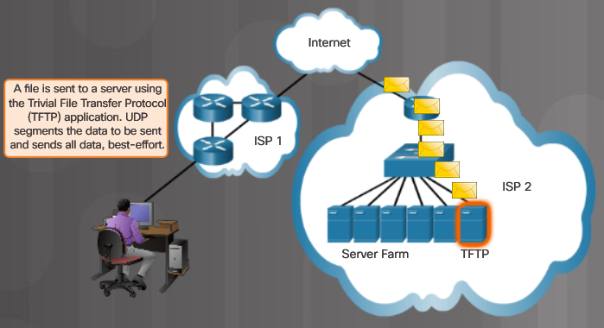
Transport Layer Protocols UDP
Very little overhead or data checking
Best-effort delivery protocol (unreliable)
No acknowledgment that the data is received by the destination
Notes:
5.2 – Network Protocols, Standards, and Services
5.2.1 – Transport Layer Protocols
5.2.1.5 – UDP
5.2.1.6 – Check Your Understanding – Transport Layer Protocols

Slide 31
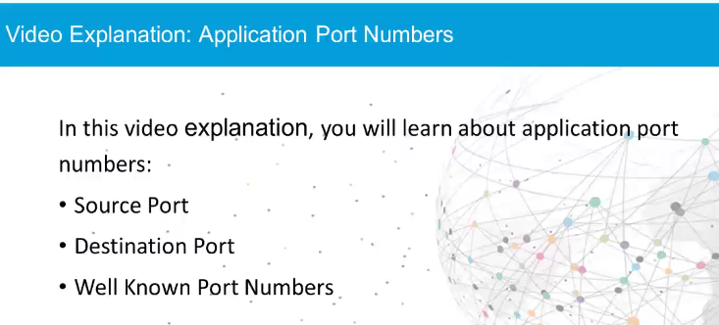
Transport Layer Protocols Video Explanation – Application Port Numbers
Notes:
5.2 – Network Protocols, Standards, and Services
5.2.2 – Application Port Numbers
5.2.2.1 – Video Explanation – Application Port Numbers

Slide 32
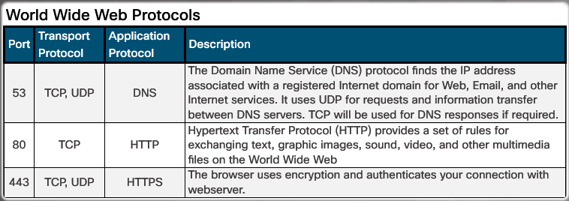
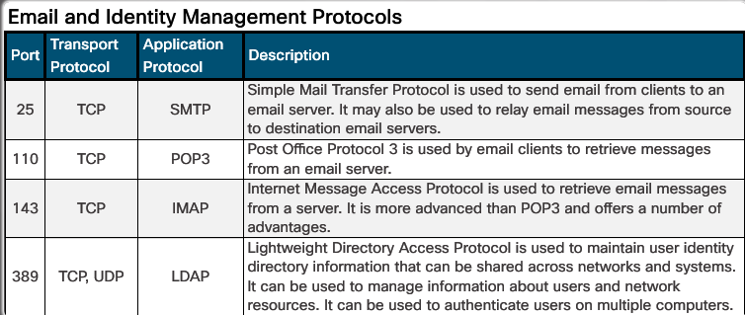
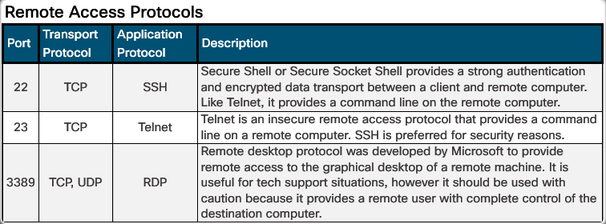
Application Port Numbers Classify Application Port Numbers
Notes:
5.2 – Network Protocols, Standards, and Services
5.2.2 – Application Port Numbers
5.2.2.2 – Classify Application Port Numbers

Slide 33
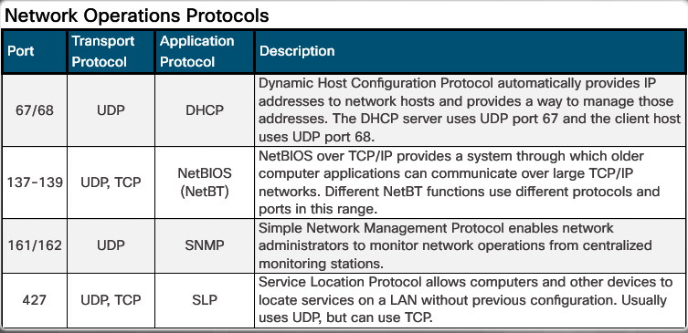
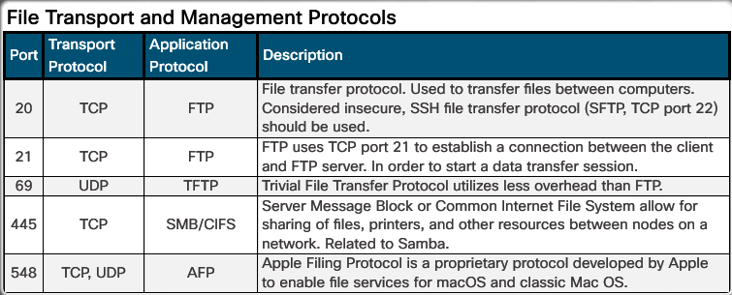
Application Port Numbers Classify Application Port Numbers (Cont.)
Notes:
5.2 – Network Protocols, Standards, and Services
5.2.2 – Application Port Numbers
5.2.2.2 – Classify Application Port Numbers (Cont.)
5.2.2.3 – Check Your Understanding – Application Port Numbers

Slide 34
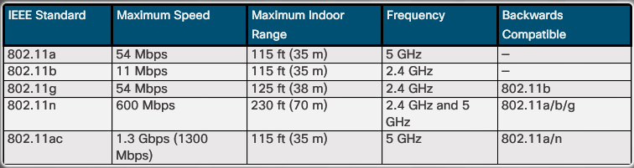
Wireless Protocols WLAN Protocols
Notes:
5.2 – Network Protocols, Standards, and Services
5.2.3 – Wireless Protocols
5.2.3.1 – WLAN Protocols

Slide 35
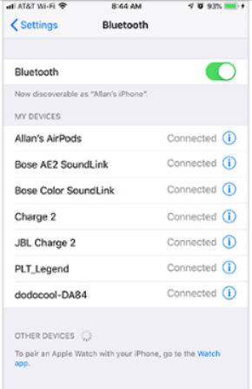


Wireless Protocols Bluetooth, NFC, and RFID
Bluetooth
Up to 7 devices to create a PAN
802.15.1
2.4 to 2.485 GHz radio frequency range
RFID
Passive or active tags used to identify items
Passive – rely on RFID reader to activate and read
Active – have a battery to broadcast the ID up to 100 meters
125 MHz to 960 MHz radio frequency range
NFC (Near Field Communication)
Devices must be in close proximity to exchange data
Used for payments, printing, public parking, etc.
Notes:
5.2 – Network Protocols, Standards, and Services
5.2.3 – Wireless Protocols
5.2.3.2 – Bluetooth, NFC, and RFID

Slide 36

Wireless Protocols Zigbee and Z-Wave
Zigbee
Requires a ZigBee Coordinator to manage client devices connected in a wireless mesh network.
Devices commonly managed from a cell phone app
IEEE 802.15.4 standard
868 MHz to 2.4 GHz range up to 20 meters, 65,000 devices, and data speeds up to 250 kb/s
Z-Wave
Proprietary standard, but public version available
232 devices can connect to a wireless mesh network with data speeds up to 100 kb/s.
Notes:
5.2 – Network Protocols, Standards, and Services
5.2.3 – Wireless Protocols
5.2.3.3 – Zigbee and Z-Wave

Slide 37
Wireless Protocols Cellular Generations
1G/2G – First generation was analog calls only. 2G introduced digital voice, conference calls, and caller ID with speeds less than 9.6 Kb/s
2.5G – supports web browsing, short audio and video clips with speeds up to 237 Kb/s.
3G – full motion video and streaming music at speeds up to 2 Mb/s
4G - IPv6, IP-based voice, gaming services, high quality multimedia at speeds up to 672 Mb/s
LTE (Long Term Evolution) – means it meets the 4G speed standards and improves connectivity while in motion. Speeds up to 100 Mb/s when mobile and up to 1 Gb/s when stationary.
5G – supports augmented reality (AR), virtual reality (VR), smart homes, smart cars, and data transfer between devices. Download speeds up to 3 Gb/s; upload speeds up to 1.5 Gb/s.
Notes:
5.2 – Network Protocols, Standards, and Services
5.2.3 – Wireless Protocols
5.2.3.4 – Cellular Generations
5.2.3.5 – Check Your Understanding – Wireless Protocols

Slide 38
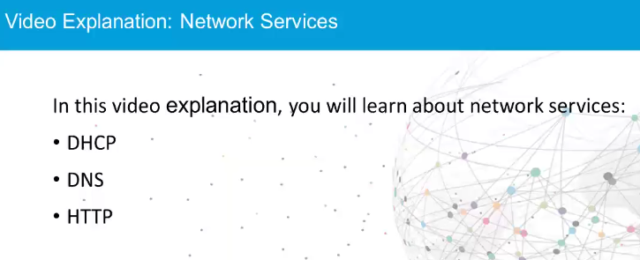
Network Services Video Explanation – Network Services
Notes:
5.2 – Network Protocols, Standards, and Services
5.2.4 – Network Services
5.2.4.1 – Video Explanation – Network Services

Slide 39
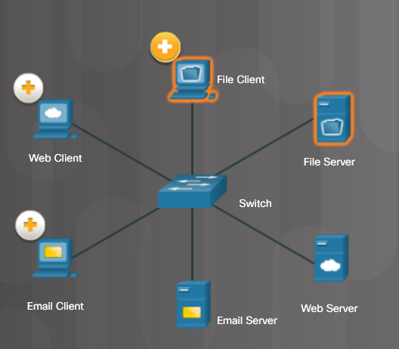
Network Services Client – Server Roles
File Client and Server
Web Client and Server
Email Client and Server
Notes:
5.2 – Network Protocols, Standards, and Services
5.2.4 – Network Services
5.2.4.2 – Client – Server Roles

Slide 40
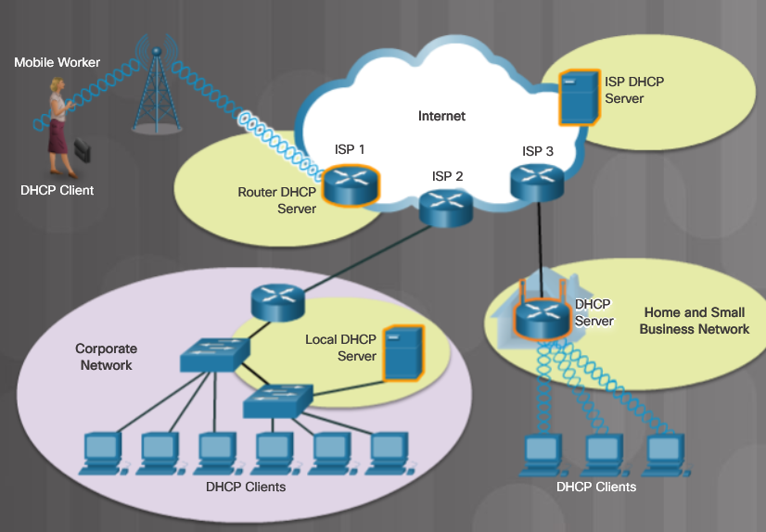
Network Services DHCP Server
A DCHP server provides IP addressing information.
Notes:
5.2 – Network Protocols, Standards, and Services
5.2.4 – Network Services
5.2.4.3 – DHCP Server

Slide 41
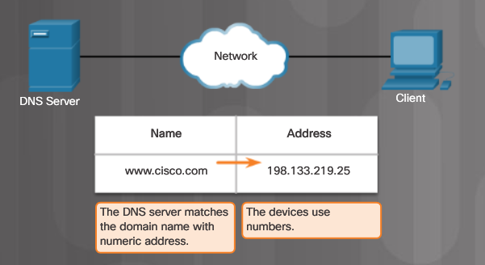
Network Services DNS Server
A DNS server translates domain names such as cisco.com to an IP address.
Notes:
5.2 – Network Protocols, Standards, and Services
5.2.4 – Network Services
5.2.4.4 – DNS Server

Slide 42
Network Services Print Server
A print server
Can control multiple printers
Provides client access to print resources
Allows centralized print job administration
Provides feedback to network clients
Notes:
5.2 – Network Protocols, Standards, and Services
5.2.4 – Network Services
5.2.4.5 – Print Server

Slide 43
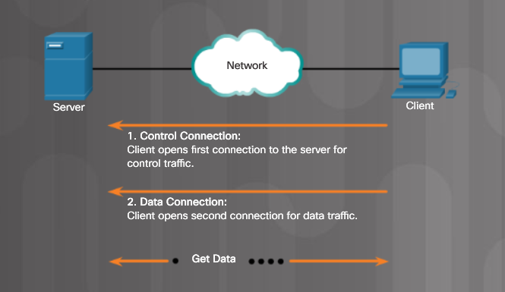
Network Services File Server
A file server allows clients to access files using a specific protocol
FTP (File Transfer Protocol)
FTPS (File Transfer Protocol Secure)
SFTP (Secure Shell File Transfer Protocol)
SCP (Secure Copy)
Notes:
5.2 – Network Protocols, Standards, and Services
5.2.4 – Network Services
5.2.4.6 – File Server

Slide 44
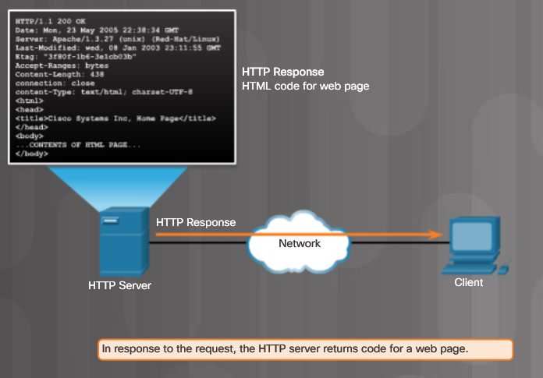
Network Services Web Server
A web server provides web resources using these protocols
Hypertext Transfer Protocol (HTTP)
TCP port 80
Secure HTTP (HTTPS)
Secure Sockets Layer (SSL)
Transport Layer Security (TLS)
TCP port 443
Notes:
5.2 – Network Protocols, Standards, and Services
5.2.4 – Network Services
5.2.4.7 – Web Server

Slide 45
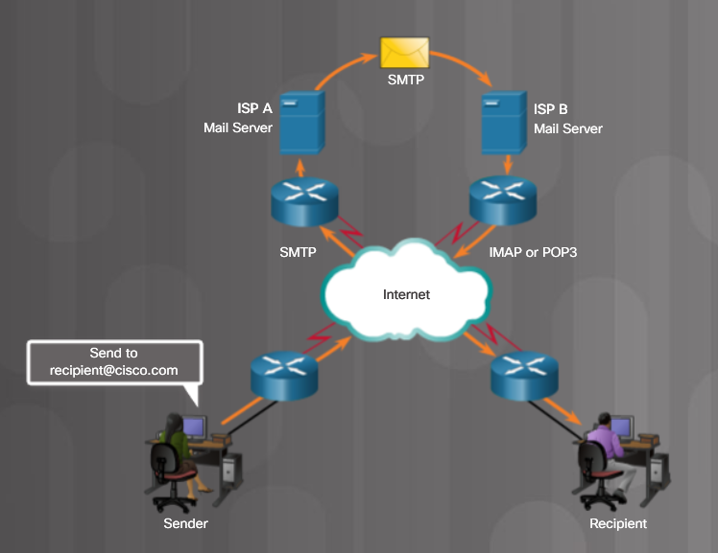
Network Services Mail Server
Email messages are stored in databases on mail servers
Client communicates with server in order to reach a different client
Protocol used to send email
Simple Mail Transfer Protocol (SMTP)
Protocols used to retrieve email
Post Office Protocol (POP)
Internet Message Access Protocol (IMAP)
Notes:
5.2 – Network Protocols, Standards, and Services
5.2.4 – Network Services
5.2.4.8 – Mail Server

Slide 46
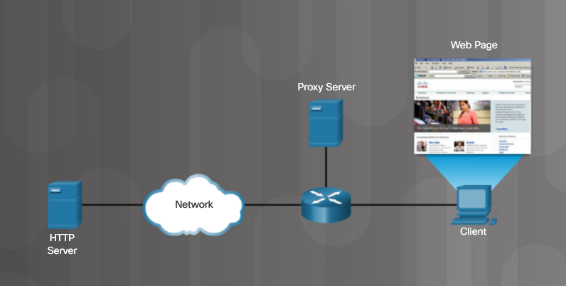
Network Services Proxy Server
Proxy servers act on behalf of a client, thus hiding the real internal host
Used to cache frequently accessed web pages
Notes:
5.2 – Network Protocols, Standards, and Services
5.2.4 – Network Services
5.2.4.9 – Proxy Server

Slide 47
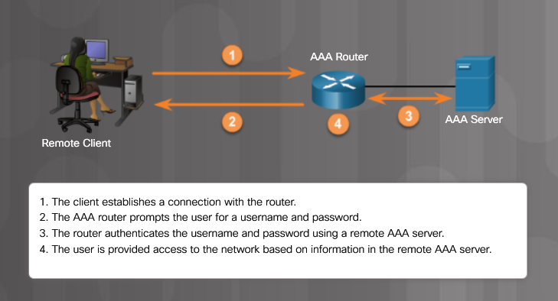
Network Services Authentication Server
Authentication, Authorization, and Accounting (AAA) - Allows access to a network device or a particular network
Notes:
5.2 – Network Protocols, Standards, and Services
5.2.4 – Network Services
5.2.4.10 – Authentication Server

Slide 48
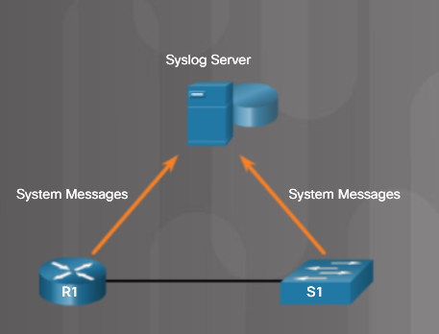
Network Services Syslog Server
Syslog stores network messages sent by networking devices.
Notes:
5.2 – Network Protocols, Standards, and Services
5.2.4 – Network Services
5.2.4.11 – Syslog Server
5.2.4.12 – Check Your Understanding – Network Services

Slide 49
5.3 Basic Network Devices
Notes:
5 – Networking Concepts
5.3 – Basic Network Devices

Slide 50
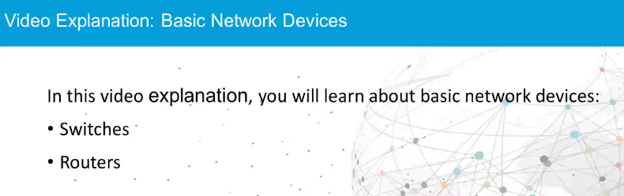
Basic Network Devices Video Explanation - Basic Network Devices
Notes:
5.3 – Network Devices
5.3.1 – Basic Network Devices
5.3.1.1 – Video Explanation – Basic Network Devices

Slide 51
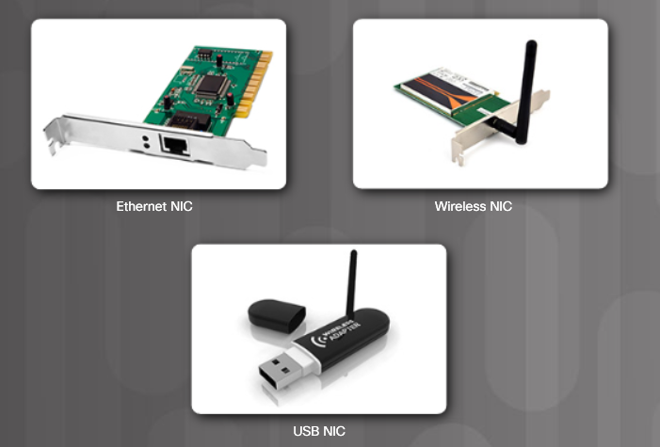
Basic Network Devices Network Interface Card
Todays computers have wired and/or wireless network capability.
Notes:
5.3 – Network Devices
5.3.1 – Basic Network Devices
5.3.1.2 – Network Interface Card

Slide 52
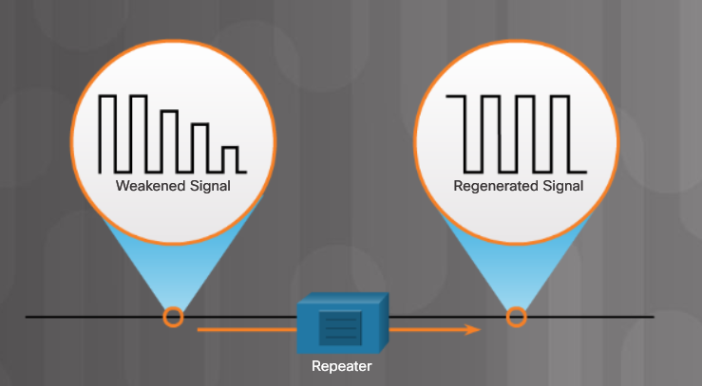
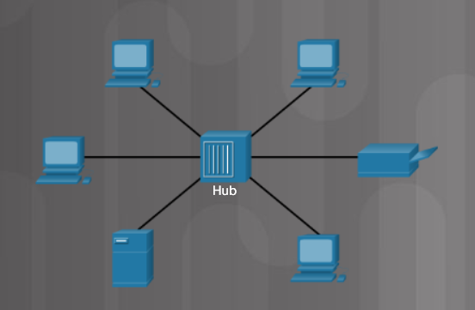
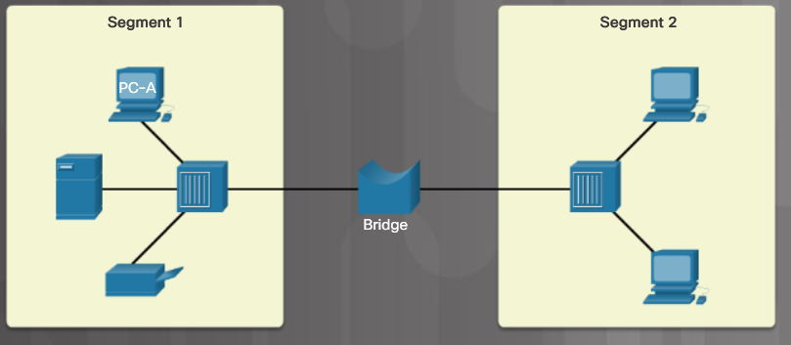
Basic Network Devices Repeaters, Bridges, and Hubs
Repeaters – Also called extenders because they regenerate the signal so it can be sent further.
Hub – Receives data on one port and sends to all other ports.
Bridge – Divides a network into two or more segments and tracks which device is on each segment.
Notes:
5.3 – Network Devices
5.3.1 – Basic Network Devices
5.3.1.3 – Repeaters, Bridges, and Hubs

Slide 53
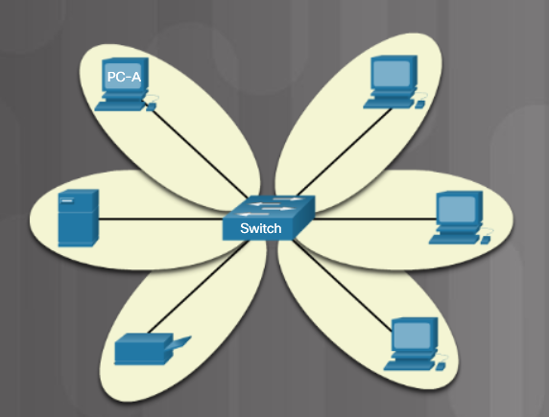
Basic Network Devices Switches
Ethernet switches record MAC addresses for each device connected to the switch.
Data is sent to a specific device if the MAC address of that device is in the MAC address table.
Managed switches are used in a company environment and have additional features.
Unmanaged switches are used in home or a small business network.
Notes:
5.3 – Network Devices
5.3.1 – Basic Network Devices
5.3.1.4 – Switches

Slide 54
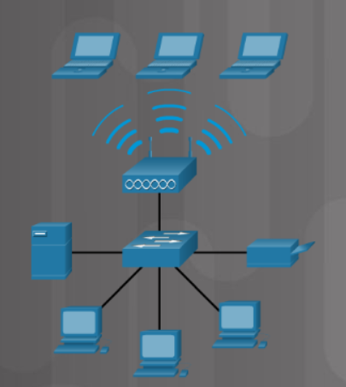
Basic Network Devices Wireless Access Points
Wireless access points (APs) – provide access to a wireless network for a limited range.
Notes:
5.3 – Network Devices
5.3.1 – Basic Network Devices
5.3.1.5 – Wireless Access Points

Slide 55
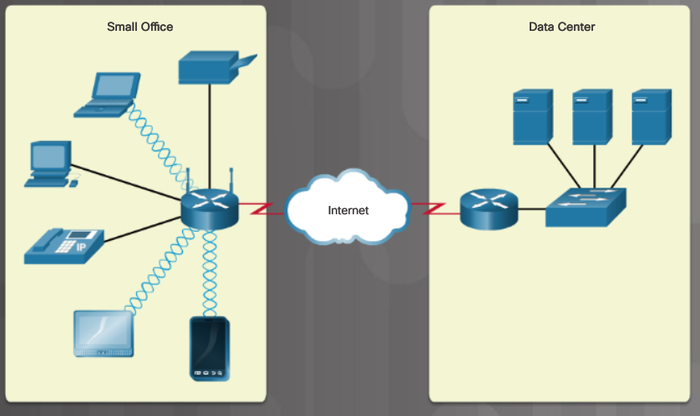
Basic Network Devices Routers
Routers connect networks.
Use an IP address to forward traffic to other networks
Can be a multipurpose device (integrated router) that includes switching and wireless capabilities
Notes:
5.3 – Network Devices
5.3.1 – Basic Network Devices
5.3.1.6 – Routers
5.3.1.7 – Check Your Understanding – Traditional Network Devices

Slide 56
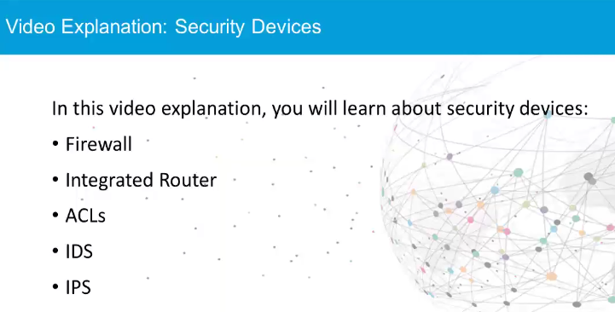
Security Devices Video Explanation – Security Devices
Notes:
5.3 – Network Devices
5.3.2 – Security Devices
5.3.2.1 – Video Explanation – Security Devices

Slide 57

Security Devices Firewalls
A firewall protects data and devices connected to a network.
Firewalls use access control lists (ACLs) which are rules used to determine whether data is permitted (allowed through) or denied.
Notes:
5.3 – Network Devices
5.3.2 – Security Devices
5.3.2.2 – Firewalls

Slide 58


Security Devices IDS and IPS
An Intrusion Detection System (IDS) monitors traffic and is a passive system.
An Intrusion Prevention System (IPS) actively monitors traffic and takes action when needed.
Notes:
5.3 – Network Devices
5.3.2 – Security Devices
5.3.2.3 – IDS and IPS

Slide 59

Security Devices UTMs
Universal Threat Management (UTM) is an all-in-one security appliance. Features are vendor-specific, but could include:
Firewall services
IDS/IPS services
Additional security services against Zero Day, Denial of Service (DoS) Distributed Denial of Service (DDoS), and spyware
Proxy and email filtering
Network access control
VPN services
Notes:
5.3 – Network Devices
5.3.2 – Security Devices
5.3.2.4 – UTMs

Slide 60

Security Devices Endpoint Management Server
An endpoint management server monitors end devices such as PCs, laptops, servers, tablets, printers, etc.
Notes:
5.3 – Network Devices
5.3.2 – Security Devices
5.3.2.5 – Endpoint Management Server
5.3.2.6 – Check Your Understanding – Security Devices

Slide 61

Other Network Devices Legacy and Embedded Systems
A legacy system is a device on the network no longer supported, but still in operation.
An embedded system is a device built into something else such as an appliance. Embedded microchips are contained in legacy systems and embedded systems.
Legacy systems and embedded systems could be a security risk.
Notes:
5.3 – Network Devices
5.3.3 – Other Network Devices
5.3.3.1 – Legacy and Embedded Systems

Slide 62

Other Network Devices Patch Panel
A centralized place where network cables attach to the back. Patch cables are used to make a connection to another patch panel which connects to a different wiring closet, or to a device such as a switch mounted nearby.
Notes:
5.3 – Network Devices
5.3.3 – Other Network Devices
5.3.3.2 – Patch Panel

Slide 63



Other Network Devices Power over Ethernet and Ethernet over Power
PoE injector
Power over Ethernet (PoE) is a standard for providing power to devices such as APs, cameras, or IP phones through a cable.
A PoE injector can be connected to a cable and a second cable is used to connect a device that receives power from the injector.
PoE switch
Ethernet over Power (powerline networking) uses existing electrical wiring to create a network.
Network cable
Notes:
5.3 – Network Devices
5.3.3 – Other Network Devices
5.3.3.3 – Power over Ethernet and Ethernet over Power

Slide 64

Other Network Devices Cloud-based Network Controller
A cloud-based network controller is a remote device used to manage network devices like access points or switches.
Notes:
5.3 – Network Devices
5.3.3 – Other Network Devices
5.3.3.4 – Cloud-based Network Controller
5.3.3.5 Check Your Understanding – Other Network Devices

Slide 65
5.4 Network Cables
Notes:
5 – Networking Concepts
5.4 – Network Cables

Slide 66

Network Tools Video Explanation – Network Cable Tools
Notes:
5.4 – Network Cables
5.4.1 – Network Tools
5.4.1.1 – Video Explanation – Network Cable Tools

Slide 67




Network Tools Network Tools and Descriptions
Wire cutters or side cutters
Wire strippers
Crimper – used to securely attach an RJ-45 connector
Punch down tool – used to terminate wires into termination
Notes:
5.4 – Network Cables
5.4.1 – Network Tools
5.4.1.2 – Network Tools and Descriptions

Slide 68





Network Tools Network Tools and Descriptions (Cont.)
Multimeter
Tone Generator
Loopback adapter – used to check a port
Cable Tester
Wi-Fi analyzer
Notes:
5.4 – Network Cables
5.4.1 – Network Tools
5.4.1.2 – Network Tools and Descriptions (Cont.)
5.4.1.3 – Check Your Understanding – Network Tools

Slide 69

Copper Cables and Connectors Cable Types
Cable types used in networking
Twisted-pair
Coaxial
Fiber-optic
Notes:
5.4 – Network Cables
5.4.2 – Copper Cables and Connectors
5.4.2.1 – Cable Types

Slide 70

Copper Cables and Connectors Coaxial Cables
Coaxial cable
Copper or aluminum
Used in cable TV systems and satellite communication systems
Harder to install, more expensive, and harder to troubleshoot than twisted-pair cabling
Notes:
5.4 – Network Cables
5.4.2 – Copper Cables and Connectors
5.4.2.2 – Coaxial Cables

Slide 71



Copper Cables and Connectors Twisted-Pair Cables
Twisted-pair cabling types
Unshielded twisted-pair (UTP)
Shielded twisted-pair (STP)
UTP
Most common
Four pairs of color-coded wires
Prone to electromagnetic interference (EMI) and radio frequency interference (RFI)
STP
Better protection against EMI and RFI
More expensive and harder to install
UTP cabling
STP cabling
Notes:
5.4 – Network Cables
5.4.2 – Copper Cables and Connectors
5.4.2.3 – Twisted-Pair Cables

Slide 72



Copper Cables and Connectors Twisted-Pair Category Ratings
Cat 5 UTP
Cat 5e UTP
Cat 6 UTP
Notes:
5.4 – Network Cables
5.4.2 – Copper Cables and Connectors
5.4.2.4 – Twisted-Pair Category Ratings

Slide 73




Copper Cables and Connectors Twisted-Pair Wire Schemes
T568A
T568B
When creating a cable to connect a network device to a wall jack or from the patch panel to a switch, make both ends of the cable the same standard.
Notes:
5.4 – Network Cables
5.4.2 – Copper Cables and Connectors
5.4.2.5 – Twisted-Pair Wire Schemes
5.4.2.6 – Check Your Understanding – T568A Cable Pinouts and T568B Cable Pinouts

Slide 74

Copper Cables and Connectors Video Explanation – Build and Test a Network Cable
Notes:
5.4 – Network Cables
5.4.2 – Copper Cables and Connectors
5.4.2.7 – Video Explanation – Build and Test a Network Cable

Slide 75
Copper Cables and Connectors Lab – Build and Test Network Cables
In this lab, you will build and test a straight-through Unshielded Twisted-Pair (UTP) Ethernet network cable.
Note: With a straight-through cable, the color of wire used by pin 1 on one end is the same color used by pin 1 on the other end, and similarly for the remaining seven pins. The cable will be constructed using either TIA/EIA T568A or T568B standards for Ethernet. This determines which color wire is to be used on each pin.
Straight-through cables are normally used to connect a host directly to a switch or a wall plate in an office area.
Notes:
5.4 – Network Cables
5.4.2 – Copper Cables and Connectors
5.4.2.8 – Lab – Build and Test Network Cables

Slide 76

Fiber Cables and Connectors Fiber-Optic Cables
Fiber-Optic cables
Use light to transmit signals
Not affected by EMI or RFI
Notes:
5.4 – Network Cables
5.4.3 – Fiber Cables and Connectors
5.4.3.1 – Fiber-Optic Cables

Slide 77


Fiber Cables and Connectors Types of Fiber Media
Single-mode fiber (SMF)
Small core
Uses laser technology to send one beam of light
Long distances
Multimode fiber (MMF)
Larger core
Uses LEDs to send light
Light is injected at different angles
Cheaper
Bandwidth up to 10 Gb/s up to 550 meters
SMF
MMF
Notes:
5.4 – Network Cables
5.4.3 – Fiber Cables and Connectors
5.4.3.2 – Types of Fiber Media

Slide 78

Fiber Cables and Connectors Fiber-Optic Connectors
Notes:
5.4 – Network Cables
5.4.3 – Fiber Cables and Connectors
5.4.3.3 – Fiber-Optic Connectors
5.4.3.4 – Check Your Understanding – Fiber Cables and Connectors

Slide 79
5.5 Chapter Summary
Notes:
5 – Networking Concepts
5.5 – Summary

Slide 80
Conclusion Chapter 5: Network Concepts
Explain components and types of computer networks.
Explain networking protocols, standards and services.
Explain the purpose of devices on a network.
Explain the characteristics of network cables.
Notes:
5.5 – Summary
5.5.1 – Conclusion
5.5.5.1 – Chapter 5: Network Concepts

Slide 81
Section 5.5 New Terms and Commands
PAN LAN VLAN WLAN WMN MAN WAN VPN SVI VLAN DSL Cable Fiber Line of Sight Wireless | Satellite Cellular Mobile hotspot and tethering TCP UDP Port numbers 802.11 WLAN protocol Bluetooth NFC RFID Zigbee Z-Wave 1G/2G, 2.5G, 3G, 3.5G, 4G, LTE, and 5G | Client-Server roles DHCP server DNS server Print server File server Web server Mail server Proxy server Authentication server Syslog server NIC Repeater Bridge Hub
Notes:
Chapter 5 - New Terms and Commands

Slide 82
Section 5.5 New Terms (cont.)
Switch Wireless access point Router Firewall IDS IPS UTM Endpoint management server Legacy system Embedded system Patch panel Power over Ethernet Ethernet over Power Cloud-based network controller | Wire cutter Wire stripper Crimper Punch down tool Multimeter Cable tester Loopback Tone generator Wi-Fi analyzer Coaxial cable UTP STP Fiber-optic cable T568A | T568B RJ-45 connector SMF MMF ST connector SC connector LC connector Duplex multimode LC connectors
Notes:
Chapter 5 - New Terms

